Slide 1
Chapter 7
Swaps

Slide 2
Nature of Swaps
A swap is an agreement to exchange cash flows at specified future times according to certain specified rules

Slide 3
An Example of a “Plain Vanilla” Overnight Indexed Swap
Deal entered into on March 8, 2022 where Apple agrees to receive 3-month SOFR & pay a fixed rate of 3% per annum every 3 months for 2 years on a notional principal of $100 million
Next slide illustrates cash flows that could occur (Day count conventions are not considered)

Slide 4
Cash Flows to Apple for One Outcome
(See Table 7.1)
Date | SOFR Rate (%) | Floating Received (‘000s) | Fixed Paid (‘000s) | Net cash flow (‘000s)
June 8, 2022 | 2.20 | 550 | 750 | -200
Sept 8, 2022 | 2.60 | 650 | 750 | -100
Dec. 8, 2022 | 2.80 | 700 | 750 | -50
Mar. 8, 2023 | 3.10 | 775 | 750 | +25
June 8, 2023 | 3.30 | 825 | 750 | +75
Sept 8, 2023 | 3.40 | 850 | 750 | +100
Dec 8, 2023 | 3.60 | 900 | 750 | +150
Mar 8, 2024 | 3.80 | 950 | 750 | +200

Slide 5
Determination of Risk-Free Interest Rates
OIS rates out to one year define zero rates because they typically involve a single exchange
OIS rate for contracts lasting longer than one year define par yield
The bootstrap method can be used to determine the zero curve

Slide 6
Bootstrap Example (Table 7.3)
OIS Maturity | OIS Rate | Compound. Freq. for OIS rate | Zero rate (cont comp.)
1 month | 1.8% | Monthly | 1.7987%
3 months | 2.0% | Quarterly | 1.9950%
6 months | 2.2% | Semiannually | 2.1880%
12 month | 2.5% | Annually | 2.4693%
2 years | 3.0% | Quarterly | 2.9994%
5 years | 4.0% | Quarterly | 4.0401%

Slide 7
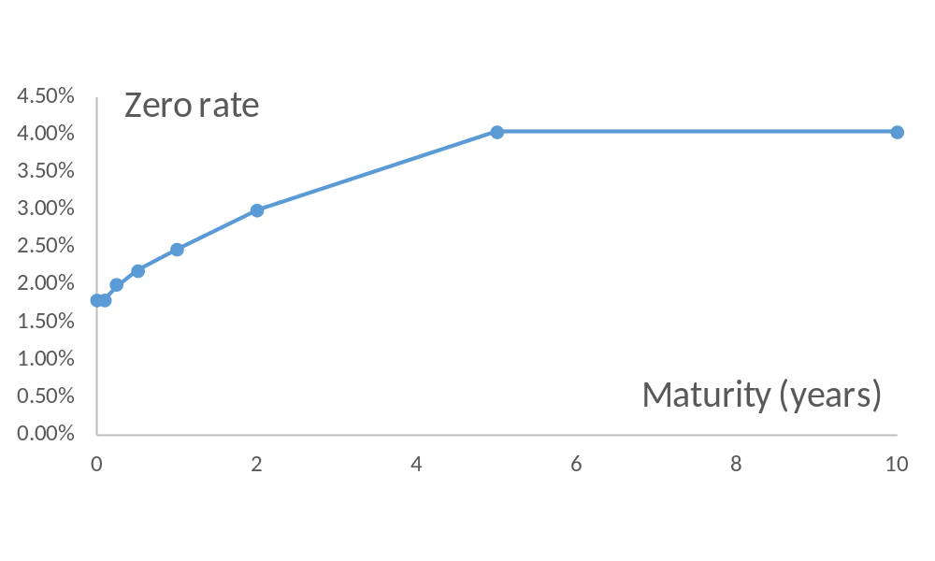
Zero Rate Given by Bootstrap Method (Figure 7.2)

Slide 8
Typical Uses of an
Interest Rate Swap
Converting a liability from
  fixed rate to floating rate
  floating rate to fixed rate
Converting an investment from
  fixed rate to floating rate
  floating rate to fixed rate

Slide 9
OIS Between Apple and Citigroup (Figure 7.1)
Citi
3.0%
Apple
Floating

Slide 10
Apple Transforms a Liability from Floating to Fixed
(Figure 7.3)
Citi
3.0%
Apple
Floating+0.1%
Floating

Slide 11
Interest Rate Swap Between Citigroup and Intel
2.97%
Citi
Intel
Floating

Slide 12
Intel Transforms a Liability from Fixed to Floating (Figure 7.4)
2.97%
Citi
Intel
3.2%
Floating

Slide 13
Apple Transforms an Asset from Fixed to Floating (Figure 7.5)
3.0%
Citi
Apple
2.7%
Floating

Slide 14
Intel Transforms an Asset from Floating to Fixed (Figure 7.6)
2.97%
Citi
Intel
Floating−0.2%
Floating

Slide 15
Quotes By a Swap Market Maker (Table 7.4)
Maturity | Bid (%) | Ask (%) | Swap Rate (%)
2 years | 2.97 | 3.00 | 2.985
3 years | 3.05 | 3.08 | 3.065
4 years | 3.15 | 3.19 | 3.170
5 years | 3.26 | 3.30 | 3.280
7 years | 3.40 | 3.44 | 3.420
10 years | 3.48 | 3.52 | 3.500

Slide 16
Day Count
A day count convention is specified for fixed and floating payments
For example, SOFR is likely to be actual/360 in the U.S.
The fixed rate might be quoted with actual/365 or 30/360

Slide 17
Confirmations
Confirmations specify the terms of a transaction
The International Swaps and Derivatives has developed Master Agreements that can be used to cover all agreements between two counterparties
CCPs are used for standard swaps between two financial institutions

Slide 18
The Comparative Advantage Argument (Table 7.5)
AAACorp wants to borrow floating
BBBCorp wants to borrow fixed
Fixed
Floating
AAACorp
4.00%
Floating ref − 0.1%
BBBCorp
5.20%
Floating ref + 0.6%

Slide 19
A Swap where Companies Trade Directly with Each Other (Figure 7.7)
4.35%
BBBCorp
4%
AAACorp
Floating+0.6%
Floating

Slide 20
The Swap when a Financial Institution (F.I.) is Involved
(Figure 7.8)
AAACorp
4.33%
F.I.
4.37%
BBBCorp
4%
Floating+0.6%
Floating
Floating

Slide 21
Criticism of the Comparative Advantage Argument
The 4.0% and 5.2% rates available to AAACorp and BBBCorp in fixed rate markets are 5-year rates
The rates available in the floating rate market are 3-month rates
BBBCorp’s fixed rate depends on the spread above floating it borrows at in the future

Slide 22
Valuation of an Interest Rate Swap
Initially interest rate swaps are worth close to zero
At later times they can be valued as a portfolio of forward rate agreements (FRAs)
The procedure is to
  Calculate floating forward rates
  Calculate the swap cash flows that will occur if floating forward rates are realized
  Discount these swap cash flows at OIS rates

Slide 23
Example (Example 7.1)
Swap involves paying 3% per annum and receiving SOFR every six months on $100 million
Swap has 1.2 years remaining (exchanges in 0.2, 0.7, and 1.2 years)
Risk-free rate for 0.2, 0.7, and 1.2 years are 2.8%, 3.2% and 3.4%, respectively (continuously compounded)
Rate observed for last 0.3 years is 2.3% continuously compounded

Slide 24
Example continued
Floating rate for the exchange at 0.2 years is assumed to be 0.6×2.3%+0.4×2.8% or 2.50% (cont comp) or 2.516% (sa)
Forward rate for 0.2 to 0.7 years is 3.36% (cont comp) or 3.388% (sa)
Forward rate for 0.7 to 1.2 years is 3.68% (cont comp) or 3.714% (sa)

Slide 25
Calculations ($ million)
Time (yrs) | Fixed cash flow | Floating cash flow | Net cash flow | Discount factor | PV of net cash flow
0.2 | −1.5000 | +1.258 | −0.242 | 0.9944 | −0.241
0.7 | −1.5000 | +1.694 | +0.194 | 0.9778 | +0.190
1.2 | −1.5000 | +1.857 | +0.357 | 0.9600 | +0.343
 |  |  |  |  | +0.292
Value of swap is $0.292 million

Slide 26
Value Changes Through Time
To party paying fixed
  How is swap value expected to change through time when term structure is upward sloping?
  How is swap value expected to change through time when term structure is downward sloping?

Slide 27
An Example of a Fixed-for-Fixed Currency Swap (Figure 7.10)
Five year agreement by BP to
Pay 3% on a US dollar principal of $15,000,000
Receive 4% on a sterling principal of £10,000,000

Slide 28
Exchange of Principal
In an interest rate swap the principal is not exchanged
In a currency swap the principal is exchanged at the beginning and the end of the swap

Slide 29
The Cash Flows (Table 7.6)
Date | Dollar Cash Flows (millions) | Sterling cash flow (millions)
Feb 1, 2022 | +15.00 | −10.00
Feb 1, 2023 | −0.45 | +0.40
Feb 1, 2024 | −0.45 | +0.40
Feb 1, 2025 | −0.45 | +0.40
Feb 1, 2026 | −0.45 | +0.40
Feb 1, 2027 | −15.45 | +10.40

Slide 30
Typical Uses of a
Currency Swap
Conversion from a liability in one currency to a liability in another currency
Conversion from an investment in one currency to an investment in another currency

Slide 31
Comparative Advantage May Be Real Because of Taxes
General Electric wants to borrow AUD
Quantas wants to borrow USD
Borrowing costs after adjusting for the differential impact of taxes could be:
 | USD | AUD
General Electric | 5.0% | 7.6%
Quantas | 7.0% | 8.0%

Slide 32
Valuation of Fixed-for-Fixed Currency Swaps
Fixed for fixed currency swaps can be valued either using forward rates or as the difference between 2 bonds

Slide 33
Currency Swap Example
All Japanese interest rates are 1.5% per annum (cont. comp.)
All USD interest rates are 2.5% per annum (cont. comp.)
3% is received in yen; 4% is paid in dollars. Payments are made annually
Principals are $10 million and 1,200 million yen
Swap will last for 3 more years
Current exchange rate is 110 yen per dollar

Slide 34
Valuation in Terms of Forward Rates (Example 7.2)
Time | DollarCash Flow | Yen cash flow | Forward rate | Dollar value of yen cash flow | Net cash flow | Present value
1 | −0.4 | +36 | 0.009182 | 0.3306 | −0.0694 | −0.0677
2 | −0.4 | +36 | 0.009275 | 0.3339 | −0.0661 | −0.0629
3 | −10.4 | +1236 | 0.009368 | 11.5786 | +1.1786 | +1.0934
Total |  |  |  |  |  | +0.9629

Slide 35
Valuation in Terms of Bonds (Example 7.3)
Time | Cash Flows ($ millions) | PV ($ millions) | Cash flows (millions of yen) | PV ( millions of yen)
1 | 0.4 | 0.3901 | 36 | 35.46
2 | 0.4 | 0.3805 | 36 | 34.94
3 | 10.4 | 9.6485 | 1,236 | 1,181.61
Total |  | 10.4191 |  | 1,252.01
Value = 1,252.01/110−10.4191 = +0.9629 millions of dollars

Slide 36
Other Currency Swaps
Fixed-for-floating: equivalent to a fixed-for-fixed currency swap plus a fixed for floating interest rate swap
Floating-for-floating: equivalent to a fixed-for-fixed currency swap plus two floating interest rate swaps

Slide 37
Swaps & Forwards
A swap can be regarded as a convenient way of packaging forward contracts
When a swap is initiated the swap has zero value, but typically some forwards have a positive value and some have a negative value

Slide 38
Credit Risk
When derivatives transactions with a counterparty are cleared bilaterally, they are netted
There is exposure if the net value of outstanding transactions is greater than the collateral posted

Slide 39
Credit Default Swaps: A Quick First Look
Notional principal (e.g. $100 million) and maturity (e.g. 5 yrs) specified
Protection buyer pays a fixed rate (e.g. 150 bp) on the notional principal (the CDS spread)
If the reference entity (a country or company) defaults protection seller buys bonds issued by the reference entity for their face value and the spread payments stop. Total face value of bonds bought equals notional principal

Slide 40
Other Types of Swaps
Amortizing/ step up
Compounding swap
Quanto (diff swap)
Equity swap
Extendible or puttable swap
Commodity swap
Volatility swap

